Slide 1
A Stronger Role for Insurance Regulators in Containing Health Care Costs
Jackson Williams
Notes:
I do not see positive innovations being stifled by overzealous regulation, although I definitely see friction and frustration.
The new and emerging business models I see are negative for consumers and are thriving because of inadequate regulation.

Slide 2
Notes:
Prices in the US are higher than in peer nations
Has anyone here been to Switzerland?
“It’s the Prices Stupid” (2003): Difference is that monopsony purchasers have the market clout in other countries
In US, buying power is diffused among multiple payers, insurance companies, government programs.
But also there is a collective action problem: No payer wants to stick its neck out and “push back” on prices:
If your only option is to walk away, why would Insurance Company A provoke a confrontation with Memorial Hospital over a price hike? Employers who want their workers to have good coverage can go over to Insurance Company B where they have a good relationship with Memorial Hospital

Slide 3
Notes:
In my view the biggest problem with US health care is that it is too expensive. The ACA enacted universal access to health insurance but many people are declining to buy it because it costs too much.
Over 8 million tax filers paid the individual mandate tax in the 2014 tax year.
11 million returns claimed an exemption from the individual shared responsibility payment

Slide 4
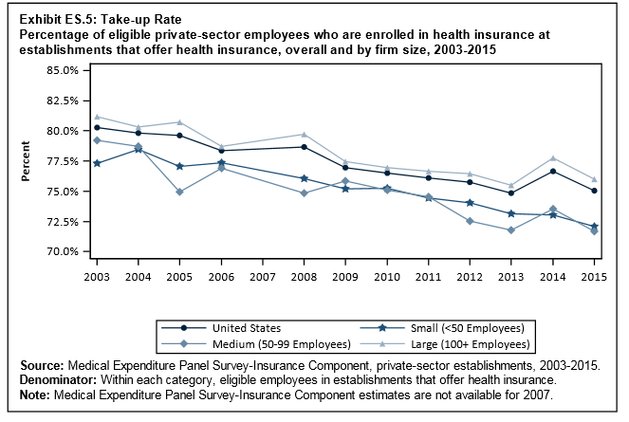
Notes:
Look at this graph from the Medical Expenditure Panel Survey (MEPS)
This is the percentage of workers who are offered insurance by their employers and accept it.
In 2003 the take-up rate was 80%.
In 2015 it is 75%. In 2003 there was no tax penalty for being uninsured, today there is, but take-up is lower.
We hear many criticisms of the ACA, but if one quarter of people who can health insurance from their jobs aren’t taking it, I would submit there is a single problem underlying both the individual and group health insurance markets: Health Care in the US is too expensive, and insurance is viewed increasingly as an unaffordable luxury

Slide 5
Notes:
$1,000 is now the median deductible for employer health plans-
Half of all workers pay the first $1,000 out of pocket
In a given year, 24% of consumers have zero health care expenditures
For those who do have health care expenditures, $1,040 is the median expenditure.
What this means is that for the average consumer in a given year, the primary role of an insurance company is not going to be paying for a medical claim
It is going to be negotiating provider prices on behalf of consumers.

Slide 6
Charges and Prices for Office Visit (Established Patient, Low Severity)
Average Billed Charge: $145
Average Negotiated Price: $48
Average Negotiated Price - Eau Claire, WI: $97
Notes:
If you go into a doctor’s office with no insurance, you will get a bill for $145
If you have insurance, you are only going to pay $48. If you do not reach your deductible, the main value you got from your insurance company was the negotiated price
If your employer is self-insured (and 60% of workers are self-insured) negotiated prices are the main thing the employer got from the insurance company was negotiated prices
BTW- Because Prescription drug prices are negotiated using rebates rather than discounts, this doesn’t apply to drug prices.
The third bullet I’ll get to in a minute

Slide 7
Center/Left Economists’ Preferred Policy Solution: All-Payer Rate Regulation
Center for American Progress: Industry-wide binding arbitration to set rates
Berenson: Cap rates at a multiple of Medicare price, e.g., 125%
Kocher: 125% rate cap triggered by high market concentration
Maryland: Global budget for health care in the state, beginning with hospitals; physicians next
1993 Clinton Plan: Rate setting by “regional alliances”
Massachusetts proposal: “Luxury tax” when price exceeds 120% of state median
Notes:
certainly in the last two cases, proponents bit off more than they could chew

Slide 8
Three “Digestible” Price Problems
Provider Market Concentration
Leverage of the “Must-Have” Provider
Out-of-Network Hospital-Based Providers
Notes:
Many would argue that without all-payer rate setting we will never get US prices down to the level of, say, New Zealand. I would agree. But I think we could get them down to a Switzerland level.
I

Slide 9
Market Concentration
Melnick and Fonkych: “Hospital prices increased substantially during a period of slow economic growth and may have been driven in part by increased market power by large, multi-hospital systems (and possibly other smaller systems) practicing ‘all-or-none’ contracting.”
Austin and Baker on physicians: “frequently found market concentration levels that appear high relative to the common view that HHI levels above 2500 are concerning. HHIs were 2500 or more in more than half of the counties studied among the chosen procedures and specialties.”
Notes:
Large hospital systems that conduct “all-or-none” contracting have reportedly added other anti-competitive language to their contracts to protect and expand their market power including clauses that prohibit health plans or employers from developing “tiered” benefit packages that would allow them to… develop new products to stimulate competition through differential cost sharing across member hospitals. Another example is so-called gag-clauses which prohibit health plans from sharing detailed hospital specific utilization and pricing data with large employers

Slide 10
The “Must-Have” Provider
Certain large and prestigious hospitals and physician groups are recognized as “must-have” parties to insurers’ provider networks, and demand and receive prices disproportionate to their clinical outcomes.
Insurers find they cannot exclude these providers from their networks nor place them in lower tiers, and pass the costs along in the form of higher premiums.

Slide 11
Out-of-Network Providers/ Surprise Medical Bills
Hospitals granting exclusive franchises for ED, anesthesiology, pathology to large physician staffing corporations
These corporations do not contract with insurers; rely on hospital’s “captive clientele” for volume
Economy of scale permits collections of UCR from insurers plus balance of charges from consumers
Accountability of out-of-network providers runs the wrong way

Slide 12
What Tools Could Insurance Regulators Use to Lower Health Care Costs?
Prior Approval of Insurance Rates
“Catchall Authority” to Prohibit Unfair Insurance Practices
Convening Insurers to Act Collectively
Notes:
These are three tools I think insurance regulators could use to lower costs. I will describe each of them and give a case scenario for how they might be used, or in a couple instances, how they have been used.

Slide 13
Rate Approval Authority
“Rates shall not be excessive, inadequate, or unfairly discriminatory.”
35 jurisdictions including DC have prior approval authority in some portion of the individual and small group market
3 states’ laws specifically cite “efficiency” or “cost containment” as a consideration
Notes:
Oregon insurers do not appear to be achieving savings from reductions in costs to Oregon hospitals, or sharing these savings with their members. Public filings from Oregon hospitals continue to demonstrate that factors including record-low levels of uncompensated care are contributing to large hospital profit margins across the state, yet consumers do not seem to be benefiting in the form of lower premiums. For example, Providence Health & Services, the state's largest hospital chain, is sitting on nearly $6 billion in cash reserves while its insurer affiliate, Providence Health Plan, wants to raise rates by nearly 30%. In light of these surpluses, it seems reasonable for insurers to expect commensurate savings on hospital costs, and to pass those savings along to consumers, but few insurers were able to identify any savings in their rate proposals—and even those insurers that have acknowledged the issue do not seem to be doing enough to address it. We are deeply concerned that, if this trend continues, Oregon consumers will keep being asked to foot the bill for costs that no longer exist in our health care system.
The researchers cited in my paper can quantify the difference in price based upon the number of competitors.
The commissioner can say, I will calculate your premium based upon two hospitals in the market. It is your job to go to court and get that hospital chain split in two. If you do that, your profit margin will be 3.5%. If you don’t, your profit margin will be 1.5%

Slide 14
“Catchall Authority”
“Any act or practice not defined in statute, which is unfair or deceptive” can be prohibited
Rhode Island: Hospital Contracting Conditions limit annual rates of price increase and require pay-for-performance element
“All or nothing” contracting another candidate for prohibition as unfair
Could “reference pricing” be facilitated or imposed?

Slide 15
Convening Insurers to Fight “Surprise” Medical Bills
Common law doctrine of quantum meruit says physician gets UCR, not “charges.”
Individual consumers, insurers have won cases limiting fees to UCR; but no organized efforts to mount “bellwether trials”
Michigan no-fault precedent from 1990s: commissioner led insurers’ united front to stop balance billing by defending collection suits; providers capitulated

